Slide 1
11.4 Type I and Type 2 Errors

Slide 2
TYPE 1 and Type 2 Errors
In this lesson we will look at 2 types of errors whenever we perform a hypothesis test for the population mean
A TYPE 1 Error is when the “Null Hypothesis” (Ho) is true but we rejected it b/c our sample was statistically significant
The probability of a Type 1 error is equal to your significance level
A Type 2 Error is when the “Null Hypothesis” is false, BUT we fail to reject it
Calculating the probability of a Type 2 error will require two things:
The significance level & the sample mean associated with it
The actual TRUE population mean and the true sampling distribution [different from your Null Hypothesis]
NOTE: You Can only calculate prob. of TYPE 2 error IF the Null is FALSE!
This section will look at the probabilities and consequences of each type of error
To determine which error (Type 1 vs Type 2) is more severe, we will need to consider the context of the question

Slide 3
CHART for : Type I and Type II errors
When we perform a hypothesis test, four outcomes are possible:
We Don’t Reject Ho
(Fail to reject Ho)
We Reject Ho
and accept Ha
We reject Ho and accept Ha
We accept Ho
(Fail to reject Ho)
This is a correct conclusion
This is called a TYPE I error
This is a correct conclusion, rejecting Ho when it is false.
This is called a TYPE 2 error
The probability of a Type I error is equal to the significance level
We accept Ho when it is not true. The probability of a Type 2 error is known as
The probability
of correctly rejecting Ho is called “POWER”
To find we need the true population mean

Slide 4
Ho is False
Ho is True
Significance Level
Reject Ho
Type I error
Correct
Fail to Reject Ho (accept Ho)
Correct
Type II error
Power: The ability to reject Ho when it is false

Slide 5
Ex) Indicate the Type 1 and Type 2 error for each scenario. Justify Which is more serious.
A hospital monitors paramedic response times and the average response time was 6.7minutes (sd=2 min). This year a sample of 400 responses had an average of 6.48 minutes. The hospital wants evidence that response times have decreased?
Type I error: Ho is true but we reject it.
Type II error: Ho is false but we fail to reject it
The avg paramedic response time is equal to 6.7min but we think it is faster (less time).
The avg response time is actually faster but we think it’s still 6.7min.
Consequence: patience requiring paramedic support may not get it in time
Conseq: Hospital may allocate unnecessary resource to train paramedics to improve response time.
Will reducing humidity affect light bulb life expectancy. A school is investing in a new $2000 dehumidifier and monitor the changes in projector bulb longevity. Average bulb life expectancy is 8000 hours.
Ho: Light bulb life expectancy is 8000 hours with dehumidifier Type I error: Dehumidifiers do not increase light bulb life but we think it does.
Type II error: Dehumidifiers do increase light bulb life but we don’t think it does
Conseq: We don’t invest in a dehumidifier and light bulb expectancy decreases. Cost more money to buy more expensive light bulbs (~$500each)
Conseq: we waste money on an expensive dehumidifier

Slide 6
Ex: A clean air standard requires that vehicle exhaust emissions not exceed specified limits for various pollutants. Many states require cars be tested annually to be sure they meet these standards. Suppose state regulators double check a random sample of cars that a suspect repair shop has certified as okay. They will revoke the shop’s license if they find significant evidence that the shop is certifying vehicles that do not meet standards. a) What are the null and alternative hypotheses? b) In this context, what is a Type I error? c) In this context, what is a Type II error? d) Which type of error would the shop’s owner consider more serious? Why? e) Which type of error might environmentalists consider more serious? Why?

Slide 7
Ex: “Red tide” is a bloom of poison-producing algae–a few different species of a class of plankton called dinoflagellates. When the weather and water conditions cause these blooms, shellfish such as clams living in the area develop dangerous levels of a paralysis-inducing toxin. In Massachusetts, the Division of Marine Fisheries (DMF) monitors levels of the toxin in shellfish by regular sampling of shellfish along the coastline. If the mean level of toxin in clams exceeds 800 μg (micrograms) of toxin per kg of clam meat in any area, clam harvesting is banned there until the bloom is over and levels of toxin in clams subside. State the Null and Alternative Hypothesis and then describe both a Type I and a Type II error in context. State which error has the greater consequences.

Slide 8
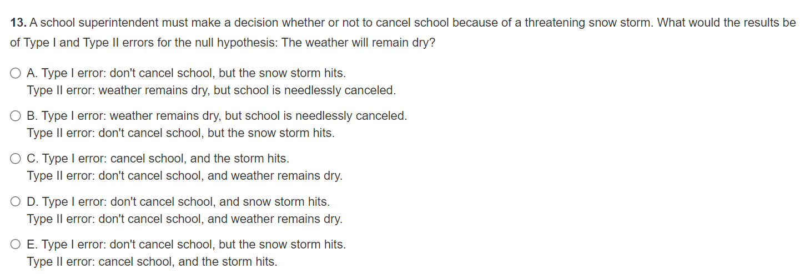

Slide 9
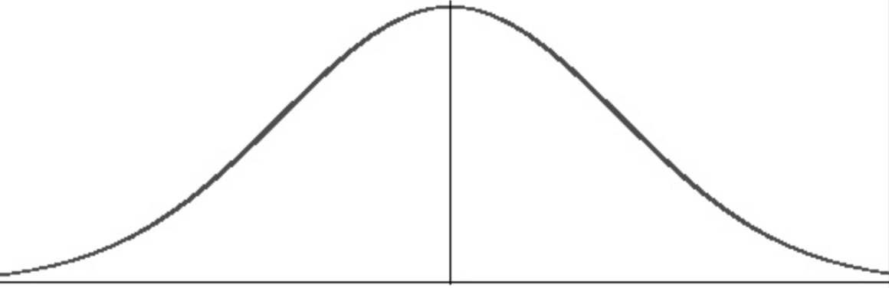

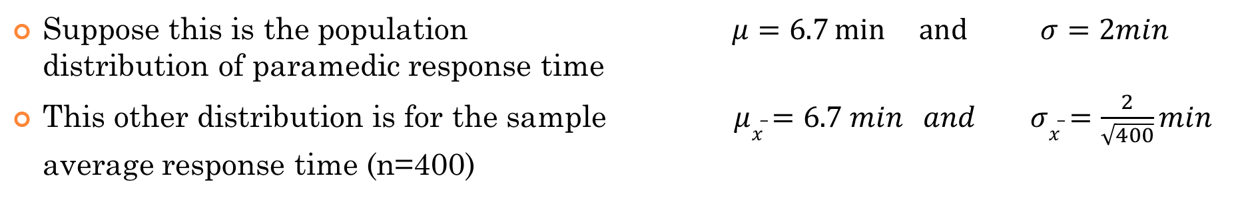
Probabilities of a Type I Error $P\left(T1 Error\right)=α$
A type I error will only occur if the Null Hypothesis (Ho) is true
The probability of a T1 Error is equal to your significance level!! (SIMPLE!!)
Suppose this is the population $μ=6.7min and{σ=2min}$ distribution of paramedic response time
This other distribution is for the sample $μ\overline{x}=6.7 min and σ\overline{x}=\frac{2}{\sqrt{400}}min$ average response time (n=400)
When we set a significance level of 1%, it corresponds with a sample mean $\left[\overline{x}α\right]$ and z-score $\left[za\right]$where this area is 1%
This area is 1%, ($α$), so 1% of your sample means will be here.
This area is 99%, so 99% of your sample means will be here

Slide 10

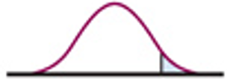
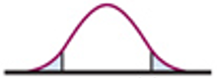
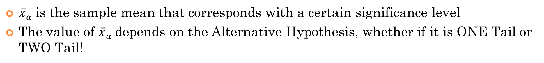
How to Find $\overline{x}α$?
$\overline{x}α$ is the sample mean that corresponds with a certain significance level
The value of $\overline{x}α$ depends on the Alternative Hypothesis, whether if it is ONE Tail or TWO Tail!
ONE TAIL TEST:
TWO TAIL TEST:

Slide 11
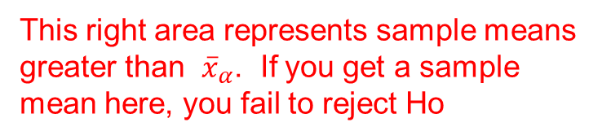
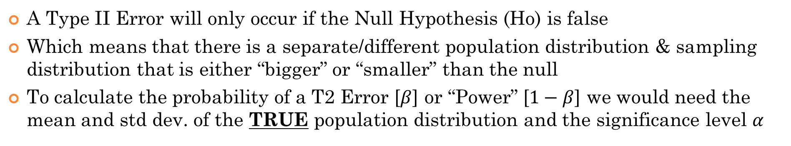
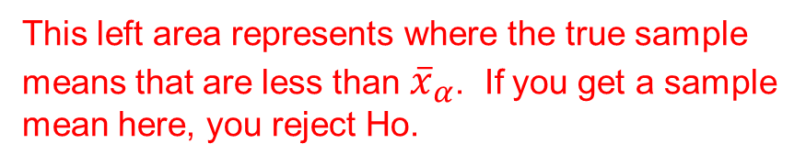
TYPE II Error $P\left(T2 Error\right)=β$
A Type II Error will only occur if the Null Hypothesis (Ho) is false
Which means that there is a separate/different population distribution & sampling distribution that is either “bigger” or “smaller” than the null
To calculate the probability of a T2 Error [$β$] or “Power” [$1−β$] we would need the mean and std dev. of the TRUE population distribution and the significance level $α$
This right area represents sample means greater than ${\overline{x}}_{α}$. If you get a sample mean here, you fail to reject Ho
This left area represents where the true sample means that are less than ${\overline{x}}_{α}$. If you get a sample mean here, you reject Ho.
This area is known as β, the probability of a Type II Error!
This area is known as Power = 1- ß

Slide 12
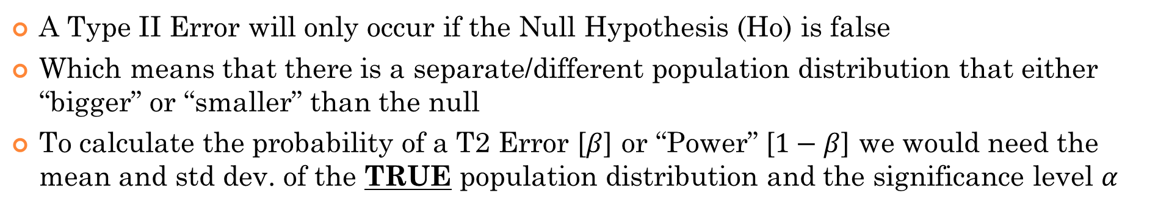
TYPE II Error $P\left(T2 Error\right)=β$
A Type II Error will only occur if the Null Hypothesis (Ho) is false
Which means that there is a separate/different population distribution that either “bigger” or “smaller” than the null
To calculate the probability of a T2 Error [$β$] or “Power” [$1−β$] we would need the mean and std dev. of the TRUE population distribution and the significance level $α$
This left area is the probability of rejecting Ho when it is false
This right area is the probability of accepting Ho when it is false
This is the probability of a Type II Error!
This is known as Power = 1- ß

Slide 13
Ex: An entrepreneur finds a location to start an upscale restaurant. Research indicates that the mean income in the neighborhood must be over $85,000 to support the business of the restaurant. Taking a SRS of 50 residents from the neighborhood, the entrepreneur will use this information to decide whether to choose this location for their restaurant. Given that =$5000 a) State the appropriate null and alternative hypothesis in the context of this question. Define your parameters b) Describe the two types of errors that might occur. Identify which is a Type I error and which is a type II error c) Which of these two types of error is more serious? Please explain d) If you had to choose one of the “standard” significance levels for your significance test, which value of “” would you choose? 0.01? 0.05? 0.1?
e) Based on your choice in part “d’, if the mean income in the area is $87,000, how likely are you to open a restaurant in that area ?
f) What is the value of ß ? Interpret the value of ß

Slide 14
Ho: μ = $85,000 [average income of residents in the neighborhood is $85000, we don’t open restaurant]
Ha: μ > $85,000 [average income of residents in the neighborhood is more than $85000, we open restaurant]
B&C) Type I error – Reject Ho when it is true. The average household income in the neighborhood is equal to $85,000 but we think it is more. So we open the restaurant. Consequences, the restaurant fails to get enough customers and begin to lose money, resulting in financial loss.
Type II error – Fail to reject Ho when it is false. The average household income in the neighborhood is greater than 85,000, but we think it is less. Ie: we think it’s a poor neighborhood when it is more affluent. Consequence: we don’t open the restaurant when it’s actually a good location. Opportunity lost, lose out on an opportunity to make money. Move on and find somewhere else.
The type I error seems to have a greater consequence than a type II error. Thus, we want to reduce the probability of a T1 error as much as possible. To do this, we would want our significance level to be lower!!!
Therefore, we should choose our significance level to be 1%

Slide 15
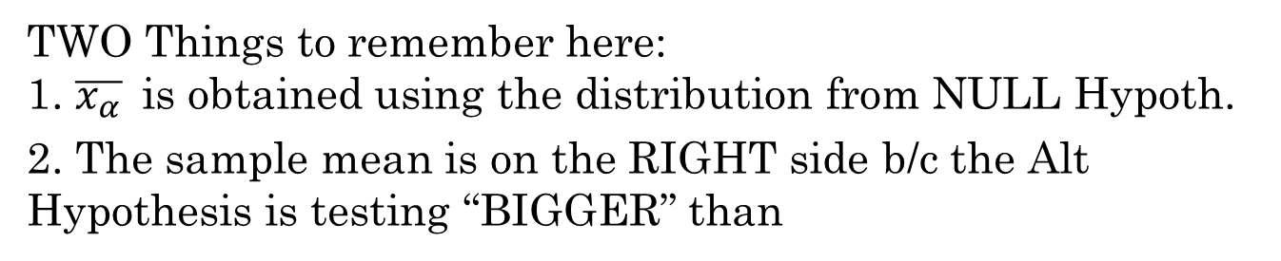
e) If we choose our significance level to be at 1%, we need to get the sample mean that corresponds to this significance level.
TWO Things to remember here: 1. $\overline{x_{α}}$is obtained using the distribution from NULL Hypoth.
2. The sample mean is on the RIGHT side b/c the Alt Hypothesis is testing “BIGGER” than
This other distribution is where the mean is greater at $87,000
The blue distribution is for sample means of size n=50
The prob. of opening the restaurant will be all this area:
The prob. of opening the restaurant if the mean household income is $87,000 will be around 69.2%
This left area on the right is 1%

Slide 16
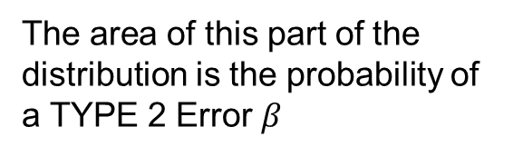
f) Beta is the probability of a TYPE II Error. To find Beta, the distribution from the NULL hypothesis is incorrect, and we should be using the distribution with mean of $87,000
The area of this part of the distribution is the probability of a TYPE 2 Error $β$
The probability of a Type 2 Error, where you don’t open the restaurant when the mean household income is $87,000 is around 30.8%

Slide 17
“
”
Ex: Hospital administrators want to improve paramedic response times to within 8 minutes, so they started looking at the “proportion” of calls where paramedics arrived within 8minutes. Last year, paramedics arrived on the scene of an accident within 8 minutes 75% of the time. The city manager wants to determine whether they have done significantly better this year:
a) State the appropriate null and alternative hypothesis for the hospital admins to test b) Describe a Type I and Type II error in this context c) Explain the consequences of each type of error d) Which is more serious? Type I error or Type II error. Justify your answer: e) Suppose you were in a life threatening injury from an accident and you need medical assistance as quickly as possible. Which of the two significance tests would you before useful to you? The one in part “a” of this question, or the following significance test: : Please explain your answer:

Slide 18
Ho: p = 0.75 [the proportion of calls where paramedics arrive within 8min is 75%
Ha: p > 0.75 [the proportion of calls where paramedics within 8 min is greater than 75%]
B&C) Type I error – Reject Ho when it is true. Hospital admin think that the proportion of calls where paramedics arrive within 8min is greater than 75% when it is not. Admin would then see no need to improve call response time when in fact it needs to. This could lead to lives being lost b/c paramedics are not arriving on time.
Type II error – Fail to reject Ho when it is false. Hospital admin think that proportion of calls where param. arrive within 8min is 75% when it is actually more. Ie: Things are better than they think. Consequence: Hospital admin may infuse more funding to improve response time when in fact it is actually doing quite well. Fixing/improving something that may not need to be fixed.
d) The type I error seems to have a greater consequence than a type II error b/c lives could be affected with delaying response time.

Slide 19
e) What this question is really asking is:
What is more important to you as an individual if you were in a situation that requires immediate support from paramedics? The proportion of calls responded within 8min OR the actual average time of a call being within 8min?
Although answers may vary, my answer would be the average time of a call responded within 8 minutes.
At a time of actual need, the mean(average) time would allow me to better prepare for how long I would need to wait until help arrives. With sampling variability, the response time could be plus or minus 3 standard deviations. I could expect 99% of the time that help will arrive within this range. Whereas, knowing the proportion is more useful from an universal or overall point of view. Knowing that 75% of calls are responded within 8 minutes does not provide a range in time that I could expect help to arrive. For instance, there’s a chance that I may be one of the calls that is not within the 75%. Therefore, I may not be able to better prepare for help to arrive.

Slide 20
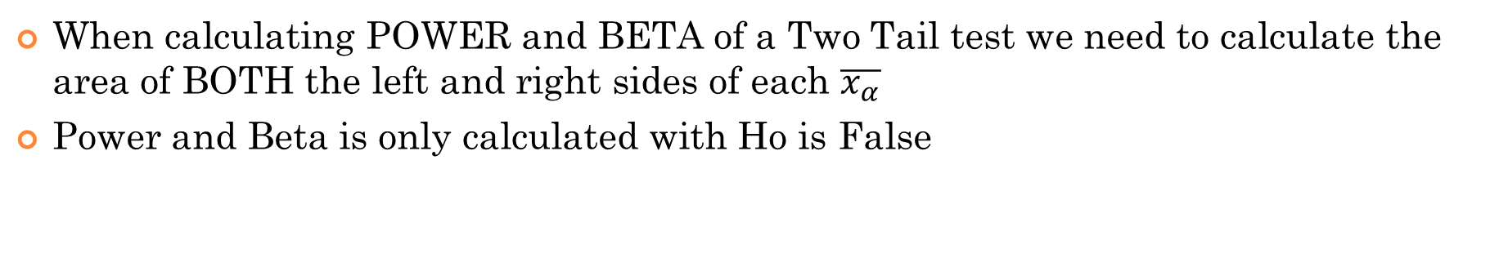
POWER and Beta of a Two Tail Test:
When calculating POWER and BETA of a Two Tail test we need to calculate the area of BOTH the left and right sides of each $\overline{x_{α}}$
Power and Beta is only calculated with Ho is False
This area in the middle is Beta, the probability of a TYPE II error
“POWER”, which is the probability of rejecting Ho when it is FALSE, is the SUM of these TWO AREAS

Slide 21
The A1C test measures the amount of hemoglobin with attached glucose and reflects your average blood glucose levels over the past 3 months. The A1C test result is reported as a percentage. The higher the percentage, the higher your blood glucose levels have been. A normal A1C level is below 5.7%. 5.7% to 6.4% prediabetes, and over 6.4% diabetes. A drug is reported to be able to lower your AIC levels by 1.5%. A SRS of 30 patient on this drug has their AIC levels before an after. The data shows the difference in percentage decrease:
a) Perform a 1% significance test for the claim that this drug will reduce A1C levels by 1.5%. Make sure to state your hypothesis and conditions
b) Indicate what a type I and II error is and their consequences
c) If the drug is only able to reduce A1C levels by 1.2%, then what are the probabilities of a Type I and II error?

Slide 22
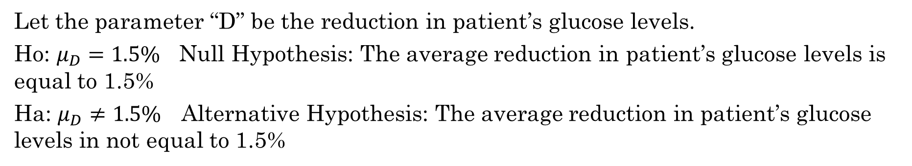
Let the parameter “D” be the reduction in patient’s glucose levels.
Ho: $μ_{D}=1.5\%$ Null Hypothesis: The average reduction in patient’s glucose levels is equal to 1.5%
Ha: $μ_{D}≠1.5\%$Alternative Hypothesis: The average reduction in patient’s glucose levels in not equal to 1.5%
Conditions:
Normality: the sample size is 30 or more, thus the distribution of sample means is normally distributed according to the Central Limit Thm
SRS: It is indicated that the sample is a SRS
Independence: The population of patients that we are sampling from is 10 times or more than 30.
To find the P-value, type the data into L1 and then perform a T-test
Our P-value is greater than our significance level, so we would fail to reject Ho and believe that the drug is reducing blood sugar levels by 1.5%

Slide 23
Type I Error: The drug is able to reduce blood sugar levels by 1.5% but we don’t think that it works. The consequence is that the drug is then not made available to patients.
Type II Error: The drug doesn’t reduce blood sugar levels by 1.5% but we think it does. Patients who end up taking the drug will get their blood sugar levels reduced by more than 1.5% or less than 1.5%. When sugar levels are reduced too much, patient health can be at risk.
The consequence of a TYPE II Error is greater, patient health is at risk vs having to use a different drug. If we increase the significance level, it reduces the probability of a TYPE II Error
c) If the drug is only able to reduce A1C levels by 1.2%, then what are the probabilities of a Type I and II error?
The probability of a TYPE I Error is the significance level $α=0.01$

Slide 24
The probability of a Type II error is harder to calculate:
Q1: Are we dealing with a Z-Distribution or a T-Distribution?
T-Distribution – b/c we don’t have the population standard deviation!
Q2: is this One Tail or Two Tail?
TWO Tail!
Q3: How do we find the two sample means?
Use the T-scores to find the sample means

Slide 25
To calculate Beta and Power, the Null Hypothesis is false. There needs to be given a TRUE mean [$μ=1.2$] with a distribution on the left
To find the area of a T-distribution, we need to convert both sample means back to a T-score, but using the new distribution!!!
With the T-values, we can calculate the area of a T-Distribution!!
This area in the middle is Beta, the probability of a TYPE II error

Slide 26
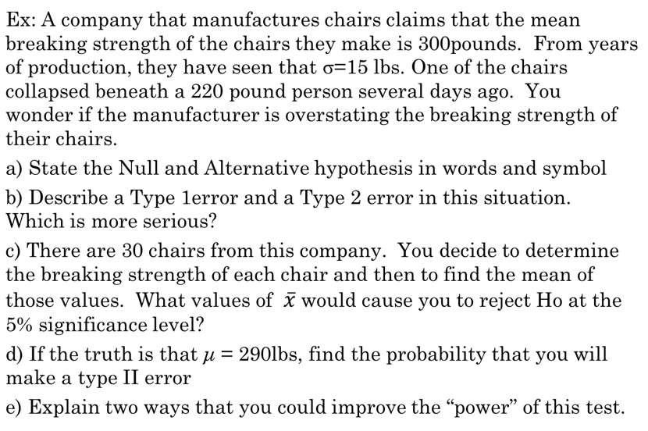

Slide 27
Ho: μ = 300 [the company’s claim is true, mean breaking strength is at 300lbs]
Ha: μ < 300 [The mean breaking strength is less than the company’s claim]
B) Type I error – The company’s claim that the chairs can support 300lbs is true, but we think that the claim is false. We claim that the chairs are not as strong as they are. Consequence: We would spend money R/D to strengthen the chairs when in fact they are already strong enough. This could lead to the chairs becoming more expensive.
Type II error – The Chairs are not as strong as stated in the Null [300lbs] but we fail to reject it. We end up thinking that the chairs are strong enough to support 300lbs, but in fact it supports a smaller weight. Consequence: This may lead to injuries when used by customers that exceed the mean breaking strength. Injuries could lead to lawsuits.
The type II error seems to have a greater consequence than a type I error.

Slide 28
300
If we get a sample mean (n=30) of 295.495lbs or less we would reject the Null Hypothesis that the mean breaking weight is 300lbs. We would accept the Alternative Hypothesis that the mean breaking weight is less than 300lbs.

Slide 29
d) A type II error is cause when we fail to reject Ho when it is false. This is what we think the distribution looks like
SINCE the population standard deviation is given, we would use a Z-distribution!! This makes the calculation MUCH EASIER!!!
So the probability of a type II error is this area:
The prob. of a type II error is 2.240%
300
e) To improve the power of a test, increase the sample size OR increase the significance level

